Slide 1
Lecture 8
Abstract Classes and Interfaces

Slide 2
Abstraction
Abstraction is a process of hiding the implementation details and showing only functionality to the user
Abstraction lets you focus on what the object does instead of how it does it
There are two ways to achieve abstraction in java
Abstract class (0 to 100%)
Interface (100%)

Slide 3

Real Life Abstarction Example
1. Let’s first take ATM machine as a real-time example. We all use an ATM machine for cash withdrawal, money transfer, retrieve min-statement, etc. in our daily life.
But we don’t know internally what things are happening inside ATM machine when you insert an ATM card for performing any kind of operation.

Slide 4
How to achieve Abstraction in Java?
Abstraction
Abstract class
Interface
Abstract class (0 to 100%)
Interface (100%)

Slide 5
Abstract class
An abstract class is one that contains the keyword abstract.
Abstract classes can’t be instantiated (can’t create objects of abstract classes). They can have constructors, static methods, and final methods.
example
abstract class Bike{
}

Slide 6
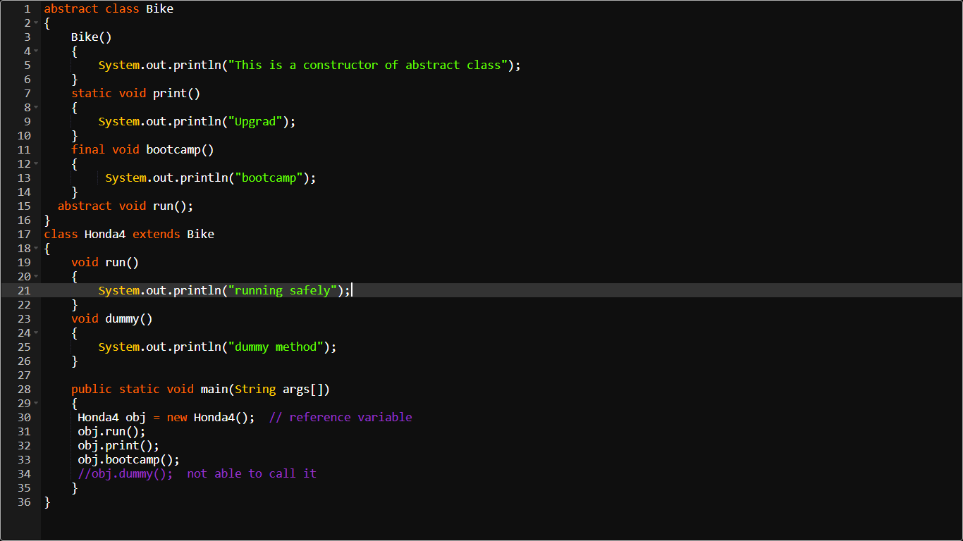
https://ide.geeksforgeeks.org/49bc1a2e-ca11-423e-980b-1555d1724913

Slide 7
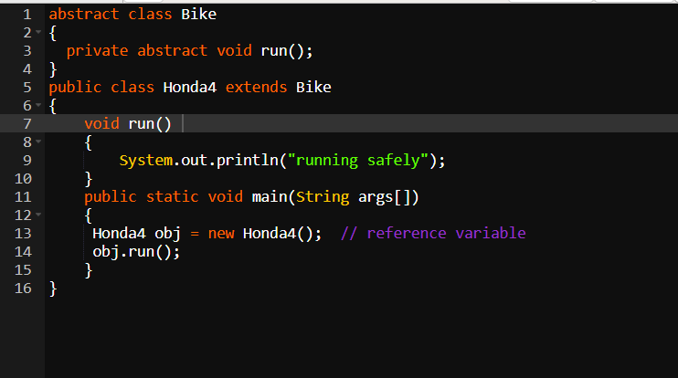
Abstract methods
An abstract method is one that contains the keyword abstract.
An abstract method doesn’t have implementation (no method body and ends up with a semi colon). It shouldn’t be marked as private.

Slide 8
Abstract class and Abstract methods
If at least one abstract method exists inside a class then the whole class should be abstract.
We can have an abstract class with no abstract methods.
We can have any number of abstract as well as non-abstract methods inside an abstract class at the same time.
The first concrete sub class of an abstract class must provide implementation to all abstract methods.
If this doesn’t happen, then the sub class also should be marked as abstract.

Slide 9
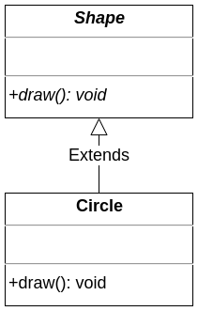
abstract class Shape { public abstract void draw(); } class Circle extends Shape{ public void draw() { System.out.println("Circle!"); } } public class Test { public static void main(String[] args) { Shape circle = new Circle(); circle.draw(); } }

Slide 10
When we want to mark a class as abstract?
Stop having actual objects of that class.
Force sub classes to implement abstract methods.
Keep having class reference.
Retain common class code.

Slide 11
Interface
An interface is a blueprint of a class.
An interface is 100% abstract. No constructors are allowed here. It represents an IS-A relationship.
NOTE: Interfaces only define required methods. We can not retain common code.
An interface can have only abstract methods, not concrete methods. By default, interface methods are public and abstract. So inside the interface, we don’t need to specify public and abstract.
So when a class implements an interface’s method without specifying the access level of that method, the compiler will throw an error stating “Cannot reduce the visibility of the inherited method from interface”. So that implemented method’s access level must be set to public.

Slide 12
interface Runnable { int a = 10; //similar to: public static final int a = 10; void run(); //similar to: public abstract void run(); }
public class InterfaceChecker implements Runnable
{ public static void main(String[] args)
{ Runnable.a = 5;//The final field Runnable.a cannot be assigned. }
}

Slide 13
interface Drawable {
void draw();
}
class Circle implements Drawable{
public void draw() {
System.out.println("Circle!");
}
}
public class InterfaceChecker {
public static void main(String[] args) {
Drawable circle = new Circle();
circle.draw();
}
}

Slide 14
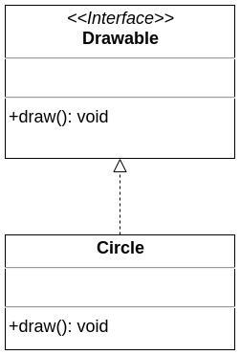

Slide 15
After Java 8
Usually we implement interface methods in a separate class. Let’s say we are required to add a new method in an interface. Then we must implement that method in that separate class, too.
To overcome this issue Java 8 introduced default and static methods that implement methods inside an interface, unlike abstract methods.

Slide 16
Default method
public interface DefaultInterface {
void sleep();
default void run() {
System.out.println("I'm running!");
}
}
public class InterfaceCheckers implements DefaultInterface{
public void sleep() {
System.out.println("Sleeping...");
}
public static void main(String[] args) {
InterfaceCheckers checker = new InterfaceCheckers();
checker.run();
checker.sleep();
}
}
/*
Output:
I'm running!
Sleeping...
*/

Slide 17
Static method
Similar to static methods of classes. We can call them by their interface’s name.
public interface DefaultInterface {
void sleep();
static void run() {
System.out.println("I'm running!");
}
}
public class InterfaceCheckers implements DefaultInterface{
public void sleep() {
System.out.println("Sleeping...");
}
public static void main(String[] args) {
InterfaceCheckers checker = new InterfaceCheckers();
DefaultInterface.run();
checker.sleep();
}
}
/*
Output:
I'm running!
Sleeping...
*/

Slide 18
When do we want to change a class to an interface?
To stop having actual objects of that class.
To force sub classes to implement abstract methods.
To keep having an interface reference.
To achieve multiple and hybrid inheritance.

